Slide 1


Unit-3

Slide 2
Simply a list is a sequence of data, and linked list is a sequence of data linked with each other.
When we want to work with unknown number of data values, we use a linked list data structure to organize that data.
Linked list is a linear data structure that contains sequence of elements such that each element links to its next element in the sequence.
Each element in a linked list is called as "Node".
What is linked list?

Slide 3
Advantages of linked lists :
Linked lists are dynamic data structures . i.e., they can grow or shrink during the execution of a program.
Linked lists have efficient memory utilization. Here, memory is not pre- allocated. Memory is allocated whenever it is required and it is de- allocated (removed) when it is no longer needed.
Insertion and Deletions are easier and efficient . Linked lists provide flexibility in inserting a data item at a specified position and deletion of the data item from the given position.
Disadvantages of linked lists:
It consumes more space because every node requires a additional pointer to store address of the next node.
Searching a particular element in list is difficult and also time consuming.

Slide 4
Types of Linked List:
Following are the various types of linked list.
Singly Linked List (Uni-directional)
Doubly Linked List (Bi-directional)
Circular Linked List

Slide 5

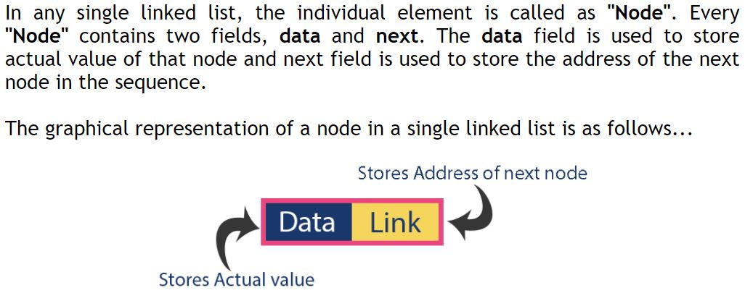
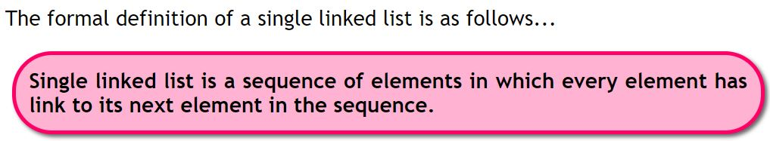

Slide 6
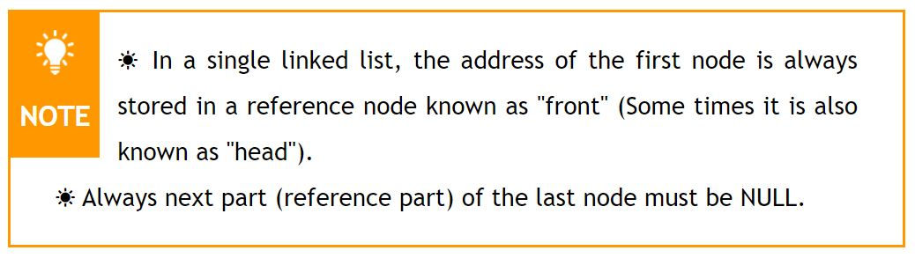
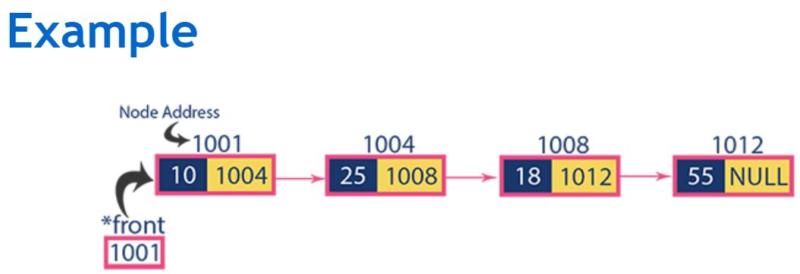
Next field is also called address field
/head
Fig: Singly Linked List

Slide 7
Basic structure of a singly linked list
Each node of a singly linked list follows a common basic structure. In a node we can store more than one data fields but we need at least single address field to store the address of next connected node.
struct node
{
int data; // Data
struct node * next; // Address
};

Slide 8
Operations
In a single linked list we perform the following operations.
Display
Insertion
Deletion

Slide 9
1. Display
Program 1
WAP in C to create a Singly linked list and display elements of linked list.
or
WAP in C to create and traverse a Singly Linked List.
Note: type this link for code.
https://codeforwin.org/2015/09/c-program-to-create-and-traverse-singly-linked-list.html

Slide 10
//C program to create and traverse a Linked List. (list1.cpp)
#include <stdio.h>
#include <conio.h>
#include <stdlib.h>
/* Structure of a node */
struct node
{
int data; // Data
struct node *next; // Address
}*head;
// Functions to create and display list
void createList(int n);
void traverseList();
void main()
{
int n;
clrscr();
printf("Enter the total number of nodes: ");
scanf("%d", &n);
createList(n);
printf("\nData in the list are: \n");
traverseList();
getch();
}
//Create a list of n nodes
void createList(int n)
{
struct node *newNode, *temp;
int data, i;
head = (struct node *)malloc(sizeof(struct node));
if(head == NULL)
{
printf("Unable to allocate memory.");
exit(0);
}
// Input data of node from the user
printf("Enter the data of node 1: ");
scanf("%d", &data);
head->data = data;//Link data field with data
head->next = NULL;//Link address field to NULL
// Create n - 1 nodes and add to list
temp = head;
for(i=2; i<=n; i++)
{
newNode = (struct node *)malloc(sizeof(struct node));
/* If memory is not allocated for newNode */
if(newNode == NULL)
{
printf("Unable to allocate memory.");
break;
}
printf("Enter the data of node %d: ", i);
scanf("%d", &data);
newNode->data = data;//Link data field of newNode
newNode->next = NULL;//Make sure new node points to NULL
temp->next = newNode;//Link previous node with newNode
temp = temp->next; //Make current node as previous node
}
}
// Display entire list
void traverseList()
{
struct node *temp;
// Return if list is empty
if(head == NULL)
{
printf("List is empty.");
return;
}
temp = head;
while(temp != NULL)
{
printf("Data = %d\n", temp->data);//Print data of current node
temp = temp->next; //Move to next node
}
}

Slide 11
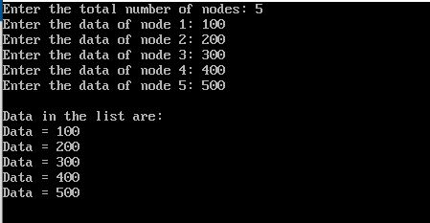
Output:

Slide 12
2. Insertion
In a single linked list, the insertion operation can be performed in three ways. They are as follows.
Inserting a node at the beginning of list.
Inserting a node at the end of list.
Inserting node at the middle (or at any position) of Singly Linked List.

Slide 13
How to insert a new node at the beginning of a Singly Linked List.

Slide 14
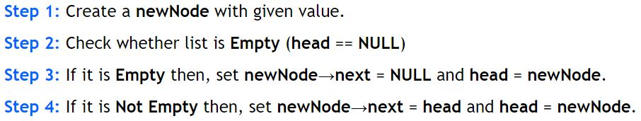
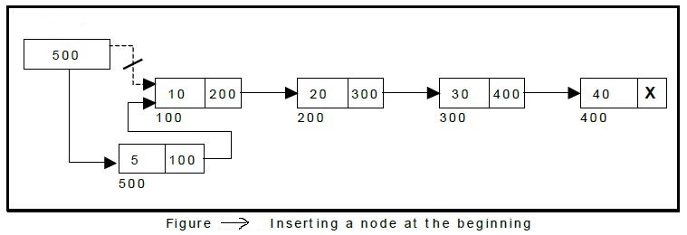
Inserting a node at the beginning of list:
Algorithm:
head/ front
New Node

Slide 15
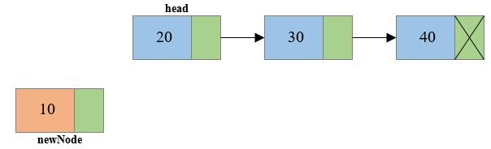
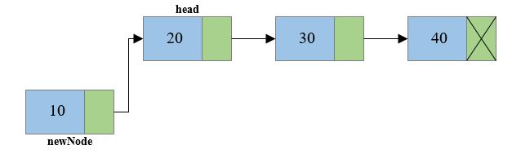
Steps to insert node at the beginning of singly linked list
Create a new node, say newNode
Link the newly created node with the head node, i.e. the newNode will now point to head node.

Slide 16
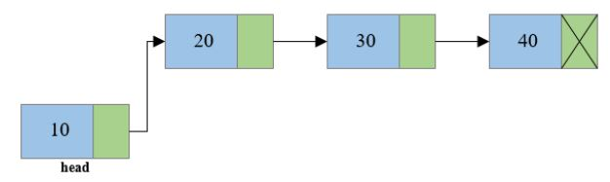
3. Finally make the new node as the head node.

Slide 17
Program 2
WAP in C to create a singly linked list of n nodes and insert a new node in the beginning of the singly linked list.
Note: type this link for code.
https://codeforwin.org/2015/09/c-program-to-insert-node-at-beginning-of-singly-linked-list.html

Slide 18
/* C program to insert a new node at the beginning
of a Singly Linked List*/ (list2.cpp)
#include <stdio.h>
#include <conio.h>
#include <stdlib.h>
// Structure of a node
struct node
{
int data; // Data
struct node *next; // Address
}*head;
void createList(int n);
void insertNodeAtBeginning(int data);
void displayList();
void main()
{
int n, data;
clrscr();
// Create a singly linked list of n nodes
printf("Enter the total number of nodes: ");
scanf("%d", &n);
createList(n);
printf("\nData in the list \n");
displayList();
//Insert data at the beginning of the singly linked list
printf("\nEnter data to insert at beginning of the list: ");
scanf("%d", &data);
insertNodeAtBeginning(data);
printf("\nData in the list \n");
displayList();
getch();
}
//Create a list of n nodes
void createList(int n)
{
struct node *newNode, *temp;
int data, i;
head = (struct node *)malloc(sizeof(struct node));
// If unable to allocate memory for head node
if(head == NULL)
{
printf("Unable to allocate memory.");
}
else
{
//Input data of node from the user
printf("Enter the data of node 1: ");
scanf("%d", &data);
head->data = data; // Link data field with data
head->next = NULL; // Link address field to NULL
temp = head;
// Create n nodes and adds to linked list
for(i=2; i<=n; i++)
{
newNode = (struct node *)malloc(sizeof(struct node));
// If memory is not allocated for newNode */
if(newNode == NULL)
{
printf("Unable to allocate memory.");
break;
}
else
{
printf("Enter the data of node %d: ", i);
scanf("%d", &data);
newNode->data = data; // Link data field of newNode with data
newNode->next = NULL; // Link address field of newNode with NULL
temp->next = newNode; // Link previous node i.e. temp to the newNode
temp = temp->next;
}
}
printf("SINGLY LINKED LIST CREATED SUCCESSFULLY\n");
}
}

Slide 19
//Create a new node and inserts at the beginning of the linked list.
void insertNodeAtBeginning(int data)
{
struct node *newNode;
newNode = (struct node*)malloc(sizeof(struct node));
if(newNode == NULL)
{
printf("Unable to allocate memory.");
}
else
{
newNode->data = data; // Link data part
newNode->next = head; // Link address part
head = newNode; // Make newNode as first node
printf("DATA INSERTED SUCCESSFULLY\n");
}
}
//Display entire list
void displayList()
{
struct node *temp;
//If the list is empty i.e. head = NULL
if(head == NULL)
{
printf("List is empty.");
}
else
{
temp = head;
while(temp != NULL)
{
printf("Data = %d\n", temp->data); // Print data of current node
temp = temp->next; // Move to next node
}
}
}

Slide 20
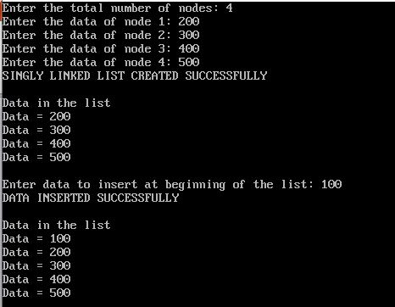
Output:

Slide 21
How to insert a new node at the end of a Singly Linked List.

Slide 22
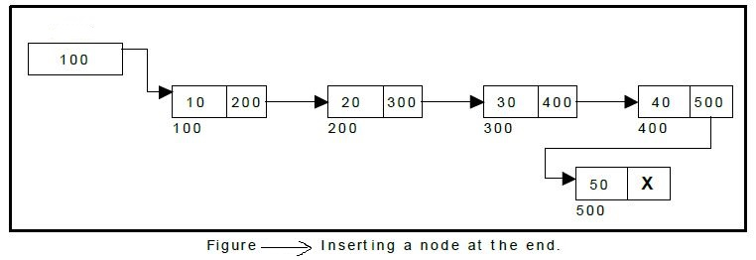
b. Inserting a node at the end of list.
Algorithm: [METHOD 1]
Step1: Create a newNode with given value.
Step2: Check whether list is Empty (head==NULL)
Step3: If it is Empty then, Set newNode -> next =NULL and head = newNode.
Step 4: If it is Not Empty then, Traverse to the last node of the linked list and connect the last node of the list with the new node, i.e. last node will now point to new node. (lastNode ->next = newNode, newnode->next = null).
head
New Node

Slide 23
b. Inserting a node at the end of list.
Algorithm: [METHOD 2]
Step 1: Create a newNode with given value and newNode → next as NULL.
Step 2: Check whether list is Empty (head == NULL).
Step 3: If it is Empty then, set head = newNode.
Step 4: If it is Not Empty then, define a node pointer temp and initialize with head.
Step 5: Keep moving the temp to its next node until it reaches to the last node in the list (until temp → next is equal to NULL).
Step 6: Set temp → next = newNode.

Slide 24
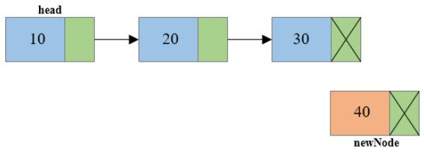
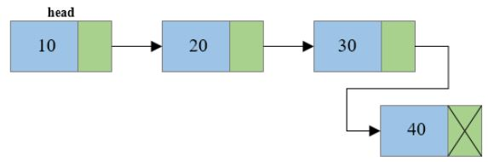
Steps to insert node at the end of Singly linked list
Create a new node and make sure that the address part (next field) of the new node points to NULL i.e. newNode->next=NULL
Traverse to the last node of the linked list and connect the last node of the list with the new node, i.e. last node will now point to new node. (lastNode->next = newNode).

Slide 25
Program 3
WAP in C to create a singly linked list of n nodes and insert a new node at the end of the singly linked list.
Note: type this link for code.
https://codeforwin.org/2015/09/c-program-to-insert-node-at-end-of-singly-linked-list.html

Slide 26
/*C program to insert new node at
the end of a Singly Linked List*/
#include <stdio.h>
#include <conio.h>
#include <stdlib.h>
/* Structure of a node */
struct node
{
int data; // Data
struct node *next; // Address
}*head;
void createList(int n);
void insertNodeAtEnd(int data);
void displayList();
void main()
{
int n, data;
clrscr();
printf("Enter the total number of nodes: ");
scanf("%d", &n);
createList(n);
printf("\nData in the list \n");
displayList();
printf("\nEnter data to insert at end of the list: ");
scanf("%d", &data);
insertNodeAtEnd(data);
printf("\nData in the list \n");
displayList();
getch();
}

Slide 27
void createList(int n)
{
struct node *newNode, *temp;
int data, i;
head = (struct node *)malloc(sizeof(struct node));
if(head == NULL)
{
printf("Unable to allocate memory.");
}
else
{
printf("Enter the data of node 1: ");
scanf("%d", &data);
head->data = data; // Link the data field with data
head->next = NULL; // Link the address field to NULL
temp = head;
for(i=2; i<=n; i++)
{
newNode = (struct node *)malloc(sizeof(struct node));
if(newNode == NULL)
{
printf("Unable to allocate memory.");
break;
}
else
{
printf("Enter the data of node %d: ", i);
scanf("%d", &data);
newNode->data = data; // Link the data field of newNode with data
newNode->next = NULL; // Link the address field of newNode with NULL
temp->next = newNode; // Link previous node i.e. temp to the newNode
temp = temp->next;
}
}
printf("SINGLY LINKED LIST CREATED SUCCESSFULLY\n");
}
}

Slide 28
void insertNodeAtEnd(int data)
{
struct node *newNode, *temp;
newNode = (struct node*)malloc(sizeof(struct node));
if(newNode == NULL)
{
printf("Unable to allocate memory.");
}
else
{
newNode->data = data; // Link the data part
newNode->next = NULL;
temp = head;
while(temp != NULL && temp->next != NULL)
temp = temp->next;
temp->next = newNode; // Link address part
printf("DATA INSERTED SUCCESSFULLY\n");
}
}
void displayList()
{
struct node *temp;
if(head == NULL)
{
printf("List is empty.");
}
else
{
temp = head;
while(temp != NULL)
{
printf("Data = %d\n", temp->data); // Print data of current node
temp = temp->next; // Move to next node
}
}
}

Slide 29
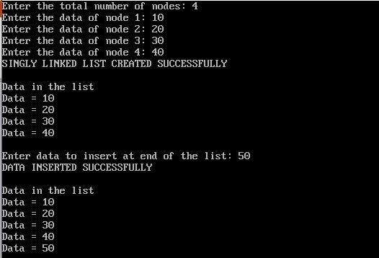
Output:

Slide 30
How to Insert a new node at the middle (or at any position) of Singly Linked List.

Slide 31
c. Inserting node at the middle (or at any position) of Singly Linked List.
Algorithm:
Step 1: Create a newNode with given value and newNode → next as NULL.
Step 2: Check whether list is Empty (head == NULL).
Step 3: If it is Empty then, set head = newNode.
Step 4: If it is Not Empty then, define a node pointer temp and initialize with head.
Step 5: Traverse to the n-1th position of the linked list and connect the new node with the n+1th node. Means the new node should point to the same node that the n-1th node is pointing to. (newNode->next = temp->next where temp is the n-1th node).
Step 6: Now at last connect the n-1th node with the new node i.e. the n-1th node will now point to new node. (temp->next = newNode where temp is the
n-1th node).

Slide 32
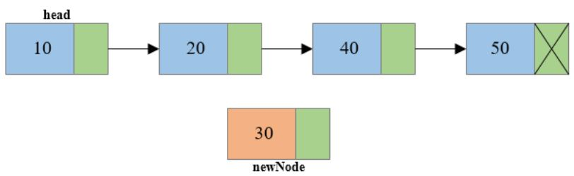
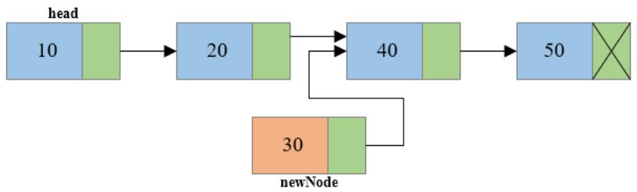
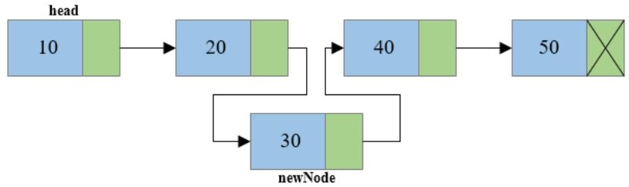
n-1th node / temp
n+1th node
n-1th node / temp
n+1th node
n-1th node / temp
n+1th node

Slide 33
Program 4
WAP in C to create a singly linked list of n nodes and insert a new node at the middle (or at any position) of the singly linked list.
Note: type this link for code.
https://codeforwin.org/2015/09/c-program-to-insert-node-at-middle-of-singly-linked-list.html

Slide 34
/**
* C program to insert new node at the middle of Singly Linked List
*/
#include <stdio.h>
#include <conio.h>
#include <stdlib.h>
/* Structure of a node */
struct node {
int data; // Data
struct node *next; // Address
}*head;
void createList(int n);
void insertNodeAtMiddle(int data, int position);
void displayList();
int main()
{
int n, data, position;
clrscr();
/*
* Create a singly linked list of n nodes
*/
printf("Enter the total number of nodes: ");
scanf("%d", &n);
createList(n);
printf("\nData in the list \n");
displayList();
/*
* Insert data at middle of the singly linked list
*/
printf("Enter data to insert at middle of the list: ");
scanf("%d", &data);
printf("Enter the position to insert new node: " );
scanf("%d", &position);
insertNodeAtMiddle(data, position);
printf("\nData in the list \n");
displayList();
getch();
return 0;
}

Slide 35
/*
* Create a list of n nodes
*/
void createList(int n)
{
struct node *newNode, *temp;
int data, i;
head = (struct node *)malloc(sizeof(struct node));
/*
* If unable to allocate memory for head node
*/
if(head == NULL)
{
printf("Unable to allocate memory.");
}
else
{
/*
* Input data of node from the user
*/
printf("Enter the data of node 1: ");
scanf("%d", &data);
head->data = data; // Link the data field with data
head->next = NULL; // Link the address field to NULL
temp = head;
/*
* Creates n nodes and adds to linked list
*/
for(i=2; i<=n; i++)
{
newNode = (struct node *)malloc(sizeof(struct node));
/* If memory is not allocated for newNode */
if(newNode == NULL)
{
printf("Unable to allocate memory.");
break;
}
else
{
printf("Enter the data of node %d: ", i);
scanf("%d", &data);
newNode->data = data; // Link the data field of newNode with data
newNode->next = NULL; // Link the address field of newNode with NULL
temp->next = newNode; // Link previous node i.e. temp to the newNode
temp = temp->next;
}
}
printf("SINGLY LINKED LIST CREATED SUCCESSFULLY\n");
}
}

Slide 36
/*
* Creates a new node and inserts at middle of the linked list.
*/
void insertNodeAtMiddle(int data, int position)
{
int i;
struct node *newNode, *temp;
newNode = (struct node*)malloc(sizeof(struct node));
if(newNode == NULL)
{
printf("Unable to allocate memory.");
}
else
{
newNode->data = data; // Link data part
newNode->next = NULL;
temp = head;
/*
* Traverse to the n-1 position
*/
for(i=2; i<=position-1; i++)
{
temp = temp->next;
if(temp == NULL)
break;
}
if(temp != NULL)
{
/* Link address part of new node */
newNode->next = temp->next;
/* Link address part of n-1 node */
temp->next = newNode;
printf("DATA INSERTED SUCCESSFULLY\n");
}
else
{
printf("UNABLE TO INSERT DATA AT THE GIVEN POSITION\n");
}
}
}

Slide 37
/*
* Display entire list
*/
void displayList()
{
struct node *temp;
/*
* If the list is empty i.e. head = NULL
*/
if(head == NULL)
{
printf("List is empty.");
}
else
{
temp = head;
while(temp != NULL)
{
printf("Data = %d\n", temp->data); // Print data of current node
temp = temp->next; // Move to next node
}
}
}

Slide 38
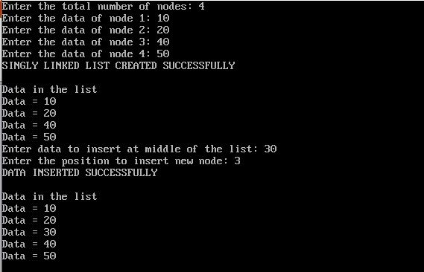
Output:

Slide 39
3. Deletion
In a single linked list, the deletion operation can be performed in three ways. They are as follows.
Deleting from Beginning of the list
Deleting from End of the list
Deleting a Specific Node(i.e middle node or at any position)

Slide 40
How to delete first node from singly linked list
NOTE:
[Good site for DSA]
http://www.btechsmartclass.com/

Slide 41
a. Deleting from Beginning of the list
Algorithm: [Method 1]
Step 1: Check whether list is Empty (head == NULL)
Step 2: If it is Empty then, display 'List is Empty!!! Deletion is not possible' and terminate the function.
Step 3: If it is Not Empty then, define a Node pointer 'temp' and initialize with head.
Step 4: Check whether list is having only one node (temp → next == NULL)
Step 5: If it is TRUE then set head = NULL and delete temp (Setting Empty list conditions)
Step 6: If it is FALSE then set head = temp → next, and delete temp.

Slide 42
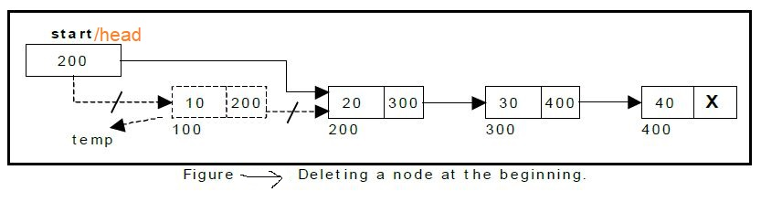

Slide 43
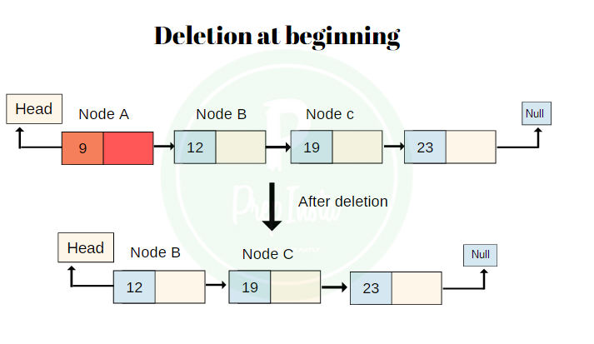
Note:
We can also make a fig like this to delete a node form beginning.

Slide 44
a. Deleting from Beginning of the list
Algorithm: [Method 2]
Read the target node or first node
If the first node is not found
Display message and stop
else
Copy the address from the address field of first node and assign to the head.
Free the first node.

Slide 45
Program 5
Write a C program to create a singly linked list of n nodes and delete the first node or beginning node of the linked list.
https://codeforwin.org/2015/09/c-program-to-delete-first-node-of-singly-linked-list.html

Slide 46
/**
* C program to delete first node
from Singly Linked List
*/
#include <stdio.h>
#include <conio.h>
#include <stdlib.h>
/* Structure of a node */
struct node {
int data; // Data
struct node *next; // Address
}*head;
void createList(int n);
void deleteFirstNode();
void displayList();
int main()
{
int n, choice;
clrscr();
/*
* Create a singly linked list of n nodes
*/
printf("Enter the total number of nodes: ");
scanf("%d", &n);
createList(n);
printf("\nData in the list \n");
displayList();
printf("\nPress 1 to delete first node: ");
scanf("%d", &choice);
/* Delete first node from list */
if(choice == 1)
deleteFirstNode();
printf("\nData in the list \n");
displayList();
getch();
return 0;
}

Slide 47
/*
* Create a list of n nodes
*/
void createList(int n)
{
struct node *newNode, *temp;
int data, i;
head = (struct node *)malloc(sizeof(struct node));
/*
* If unable to allocate memory for head node
*/
if(head == NULL)
{
printf("Unable to allocate memory.");
}
else
{
/*
* In data of node from the user
*/
printf("Enter the data of node 1: ");
scanf("%d", &data);
head->data = data; // Link the data field with data
head->next = NULL; // Link the address field to NULL
temp = head;
/*
* Create n nodes and adds to linked list
*/
for(i=2; i<=n; i++)
{
newNode = (struct node *)malloc(sizeof(struct node));
/* If memory is not allocated for newNode */
if(newNode == NULL)
{
printf("Unable to allocate memory.");
break;
}
else
{
printf("Enter the data of node %d: ", i);
scanf("%d", &data);
newNode->data = data; // Link the data field of newNode with data
newNode->next = NULL; // Link the address field of newNode with NULL
temp->next = newNode; // Link previous node i.e. temp to the newNode
temp = temp->next;
}
}
printf("SINGLY LINKED LIST CREATED SUCCESSFULLY\n");
}
}

Slide 48
/*
* Deletes the first node of the linked list
*/
void deleteFirstNode()
{
struct node *toDelete;
if(head == NULL)
{
printf("List is already empty.");
}
else
{
toDelete = head;
head = head->next;
printf("\nData deleted = %d\n", toDelete->data);
/* Clears the memory occupied by first node*/
free(toDelete);
printf("SUCCESSFULLY DELETED FIRST NODE FROM LIST\n");
}
}
/*
* Displays the entire list
*/
void displayList()
{
struct node *temp;
/*
* If the list is empty i.e. head = NULL
*/
if(head == NULL)
{
printf("List is empty.");
}
else
{
temp = head;
while(temp != NULL)
{
printf("Data = %d\n", temp->data); // Print data of current node
temp = temp->next; // Move to next node
}
}
}

Slide 49
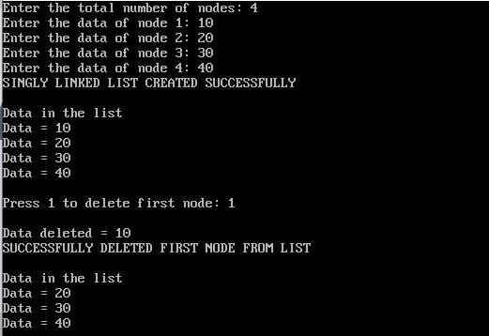
Output:

Slide 50
How to delete last node from singly linked list

Slide 51
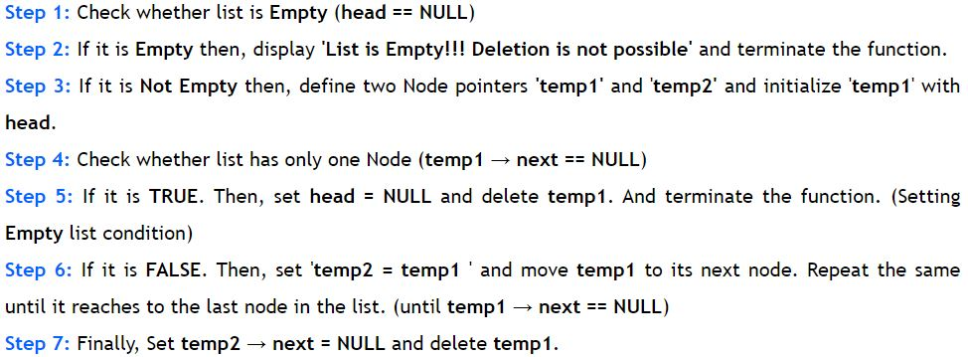
b. Deleting from End of the list
Algorithm: [METHOD 1]

Slide 52
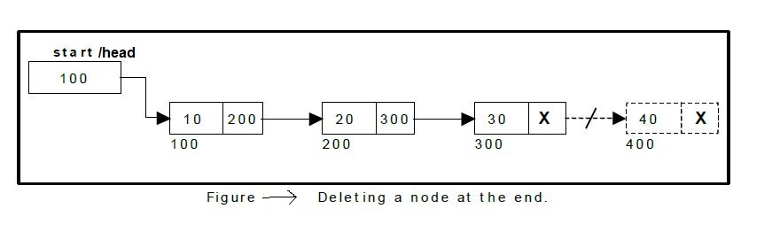

Slide 53
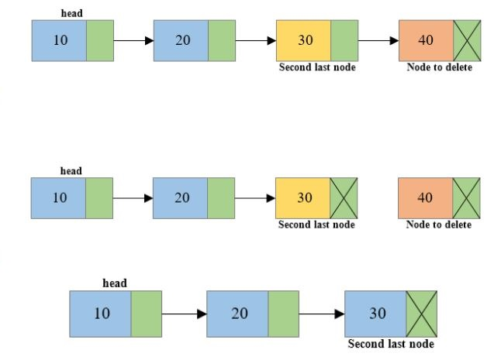
Note:
We can also draw a figure like this for deletion of node at last.

Slide 54
b. Deleting from End of the list
Algorithm: [METHOD 2]
Read the target node
If target node is not found
Display message and stop
else
Traverse the list to the second last node.
Assign null value to the address field of second last node.
Free the last node.

Slide 55
PROGRAM 6
Write a C program to create a singly linked list of n nodes and delete the last node of the list.
https://codeforwin.org/2015/09/c-program-to-delete-last-node-of-singly-linked-list.html

Slide 56
/**
* C program to delete last node of Singly Linked List
*/
#include <stdio.h>
#include <conio.h>
#include <stdlib.h>
/* Structure of a node */
struct node {
int data; // Data
struct node *next; // Address
}*head;
void createList(int n);
void deleteLastNode();
void displayList();
int main()
{
int n, choice;
clrscr();
/*
* Create a singly linked list of n nodes
*/
printf("Enter the total number of nodes: ");
scanf("%d", &n);
createList(n);
printf("\nData in the list \n");
displayList();
printf("\nPress 1 to delete last node: ");
scanf("%d", &choice);
/* Delete last node from list */
if(choice == 1)
deleteLastNode();
printf("\nData in the list \n");
displayList();
getch();
return 0;
}

Slide 57
/*
* Create a list of n nodes
*/
void createList(int n)
{
struct node *newNode, *temp;
int data, i;
head = (struct node *)malloc(sizeof(struct node));
/*
* If unable to allocate memory for head node
*/
if(head == NULL)
{
printf("Unable to allocate memory.");
}
else
{
/*
* Input data of node from the user
*/
printf("Enter the data of node 1: ");
scanf("%d", &data);
head->data = data; // Link the data field with data
head->next = NULL; // Link the address field to NULL
temp = head;
/*
* Create n nodes and adds to linked list
*/
for(i=2; i<=n; i++)
{
newNode = (struct node *)malloc(sizeof(struct node));
/* If memory is not allocated for newNode */
if(newNode == NULL)
{
printf("Unable to allocate memory.");
break;
}
else
{
printf("Enter the data of node %d: ", i);
scanf("%d", &data);
newNode->data = data; // Link the data field of newNode with data
newNode->next = NULL; // Link the address field of newNode with NULL
temp->next = newNode; // Link previous node i.e. temp to the newNode
temp = temp->next;
}
}
printf("SINGLY LINKED LIST CREATED SUCCESSFULLY\n");
}
}

Slide 58
/*
* Delete last node of the linked list
*/
void deleteLastNode()
{
struct node *toDelete, *secondLastNode;
if(head == NULL)
{
printf("List is already empty.");
}
else
{
toDelete = head;
secondLastNode = head;
/* Traverse to the last node of the list */
while(toDelete->next != NULL)
{
secondLastNode = toDelete;
toDelete = toDelete->next;
}
if(toDelete == head)
{
head = NULL;
}
else
{
/* Disconnect link of second last node with last node */
secondLastNode->next = NULL;
}
/* Delete the last node */
free(toDelete);
printf("SUCCESSFULLY DELETED LAST NODE OF LIST\n");
}
}
/*
* Display entire list
*/
void displayList()
{
struct node *temp;
/*
* If the list is empty i.e. head = NULL
*/
if(head == NULL)
{
printf("List is empty.");
}
else
{
temp = head;
while(temp != NULL)
{
printf("Data = %d\n", temp->data); // Print the data of current node
temp = temp->next; // Move to next node
}
}
}

Slide 59
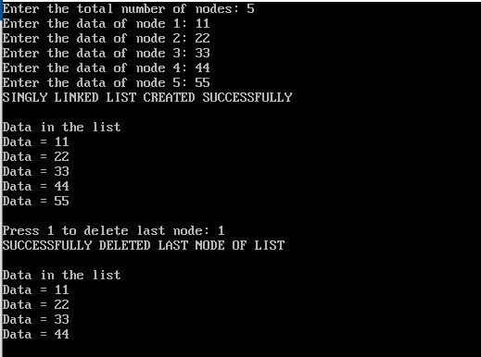
Output:

Slide 60
How to delete node from the middle (or at any position) of the singly linked list

Slide 61
c. delete middle node (or at any position) from singly linked list
Algorithm
Step 1: Check whether list is Empty (head == NULL)
Step 2: If it is Empty then, display 'List is Empty!!! Deletion is not possible' and terminate the function.
Step 3: If it is Not Empty then, define a Node pointer 'temp' and initialize with head.
Step 4: Check whether list has only one Node (temp1 → next == NULL)
Step 5: If it is TRUE. Then, set head = NULL and delete temp1. And terminate the function. (Setting Empty list condition)
Step 6: If it is FALSE then Traverse to the n^{th} node of the singly linked list and also keep reference of n-1th node in some temp variable say prevnode.
Step 7: Reconnect the n-1th node with the n+1th node
i.e. prevNode->next = toDelete->next (Where prevNode is n-1th node and toDelete node is the n^{th} node and toDelete->next is the n+1th node).
Step 8: Free the memory occupied by the n^{th} node i.e. toDelete node

Slide 62
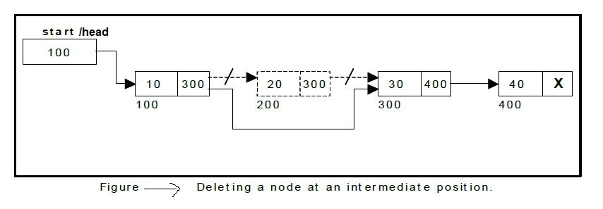

Slide 63
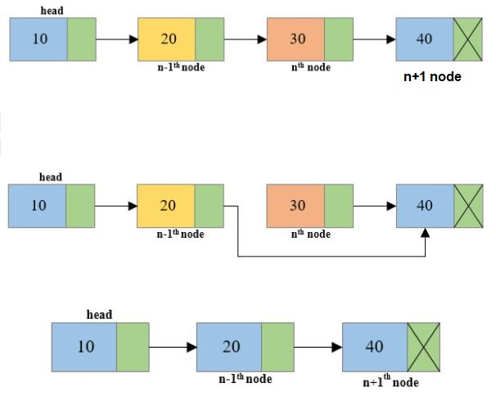
Note:
We can also draw a figure like this for deletion of node at middle.

Slide 64
PROGRAM 7
Write a C program to create a singly linked list of n nodes and delete node from the middle (or at any position) of the linked list.
https://codeforwin.org/2015/09/c-program-to-delete-middle-node-of-singly-linked-list.html

Slide 65
/**
* C program to delete middle node of Singly Linked List
*/
#include <stdio.h>
#include <conio.h>
#include <stdlib.h>
/* Structure of a node */
struct node {
int data; // Data
struct node *next; // Address
} *head;
/* Functions used in program */
void createList(int n);
void deleteMiddleNode(int position);
void displayList();
int main()
{
int n, position;
clrscr();
/*
* Create a singly linked list of n nodes
*/
printf("Enter the total number of nodes: ");
scanf("%d", &n);
createList(n);
printf("\nData in the list \n");
displayList();
printf("\nEnter the node position you want to delete: ");
scanf("%d", &position);
/* Delete middle node from list */
deleteMiddleNode(position);
printf("\nData in the list \n");
displayList();
getch();
return 0;
}

Slide 66
/*
* Create a list of n nodes
*/
void createList(int n)
{
struct node *newNode, *temp;
int data, i;
head = (struct node *)malloc(sizeof(struct node));
/*
* If unable to allocate memory for head node
*/
if(head == NULL)
{
printf("Unable to allocate memory.");
}
else
{
/*
* Read data of node from the user
*/
printf("Enter the data of node 1: ");
scanf("%d", &data);
head->data = data; // Link the data field with data
head->next = NULL; // Link the address field to NULL
temp = head;
/*
* Create n nodes and adds to linked list
*/
for(i=2; i<=n; i++)
{
newNode = (struct node *)malloc(sizeof(struct node));
/* If memory is not allocated for newNode */
if(newNode == NULL)
{
printf("Unable to allocate memory.");
break;
}
else
{
printf("Enter the data of node %d: ", i);
scanf("%d", &data);
newNode->data = data; // Link the data field of newNode with data
newNode->next = NULL; // Link the address field of newNode with NULL
temp->next = newNode; // Link previous node i.e. temp to the newNode
temp = temp->next;
}
}
printf("SINGLY LINKED LIST CREATED SUCCESSFULLY\n");
}
}

Slide 67
/*
* Delete middle node of the linked list
*/
void deleteMiddleNode(int position)
{
int i;
struct node *toDelete, *prevNode;
if(head == NULL)
{
printf("List is already empty.");
}
else
{
toDelete = head;
prevNode = head;
for(i=2; i<=position; i++)
{
prevNode = toDelete;
toDelete = toDelete->next;
if(toDelete == NULL)
break;
}
if(toDelete != NULL)
{
if(toDelete == head)
head = head->next;
prevNode->next = toDelete->next;
toDelete->next = NULL;
/* Delete nth node */
free(toDelete);
printf("SUCCESSFULLY DELETED NODE FROM MIDDLE OF LIST\n");
}
else
{
printf("Invalid position unable to delete.");
}
}
}
/*
* Display entire list
*/
void displayList()
{
struct node *temp;
/*
* If the list is empty i.e. head = NULL
*/
if(head == NULL)
{
printf("List is empty.");
}
else
{
temp = head;
while(temp != NULL)
{
printf("Data = %d\n", temp->data); // Print the data of current node
temp = temp->next; // Move to next node
}
}
}

Slide 68
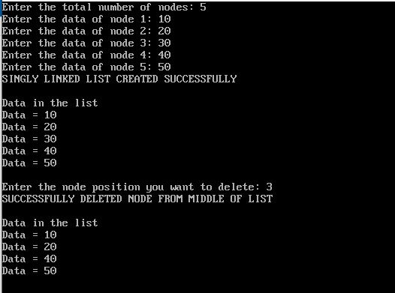
Output:

Slide 69
Advantages of Singly linked list
Singly linked list is probably the most easiest data structure to implement.
Insertion and deletion of element can be done easily.
Insertion and deletion of elements doesn't requires movement of all elements when compared to an array.
Requires less memory when compared to doubly and circular linked list.
Can allocate or de-allocate memory easily when required during its execution.
It is one of most efficient data structure to implement when traversing in one direction is required.

Slide 70
Disadvantages of Singly linked list
It uses more memory when compared to an array.
Since elements are not stored sequentially hence requires more time to access each elements of list.
Traversing in reverse is not possible in case of Singly linked list when compared to Doubly linked list.
Requires O(n) time on appending a new node to end.

Slide 71


Double Linked List
In a single linked list, every node has link to its next node in the sequence. So, we can traverse from one node to other node only in one direction and we can not traverse back. We can solve this kind of problem by using double linked list. Double linked list can be defined as follows:
Or
Doubly linked list is a collection of nodes linked together in a sequential way. Each node of the list contains two parts data part and the reference or address part.

Slide 72

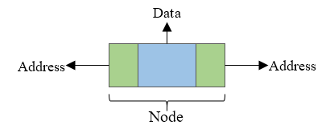
In double linked list, every node has link to its previous node and next node. So, we can traverse forward by using next field and can traverse backward by using previous field. Every node in a double linked list contains three fields and the basic structure of node is shown in the following figure.
Or

Slide 73
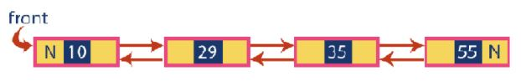
Here, 'link1' field is used to store the address of the previous node in the sequence, 'link2' field is used to store the address of the next node in the sequence and 'data' field is used to store the actual value of that node.
Doubly linked list is sometimes also referred as bi-directional linked list since it allows traversal of nodes in both direction. The basic structure of a doubly linked list is represented as:

Slide 74
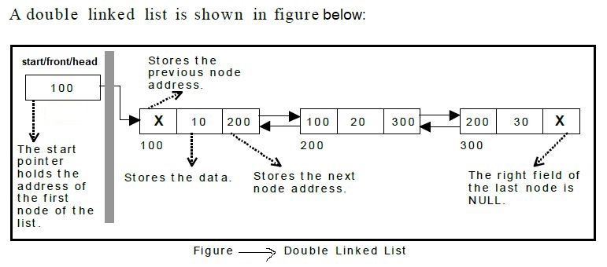
Example:

Slide 75
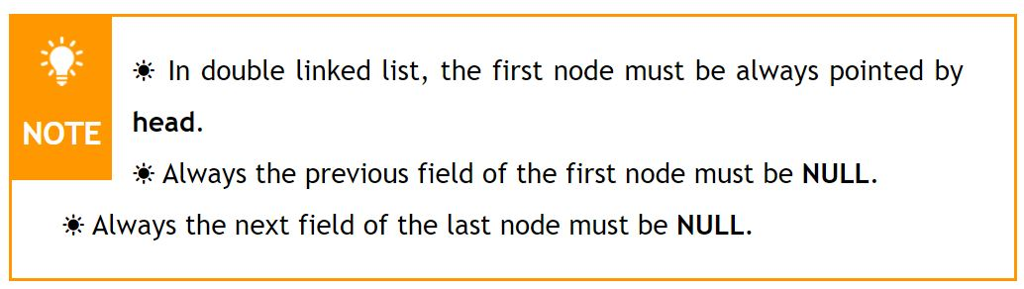
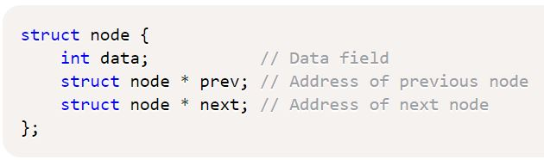
Basic structure of a doubly linked list
The basic structure of a doubly linked list contains a data field and two address fields.

Slide 76
Operations
In a Doubly linked list we perform the following operations.
Display
Insertion
Deletion

Slide 77
1. Display
Program 8
Write a C program to create a doubly linked list and display all nodes of the created list.
or
WAP in C to create and traverse a Doubly Linked List.
Note: type this link for code.
https://codeforwin.org/2015/10/c-program-to-create-and-traverse-doubly-linked-list.html#creation-algorithm

Slide 78
/**
* C program to create and display Doubly linked list. [double1.cpp] */
#include <stdio.h>
#include <conio.h>
#include <stdlib.h>
/*
* Basic structure of Node
*/
struct node {
int data;
struct node * prev;
struct node * next;
}*head, *last;
/*
* Function used in this program
*/
void createList(int n);
void displayListFromFirst();
void displayListFromEnd();
int main()
{
int n, choice;
clrscr();
head = NULL;
last = NULL;
printf("Enter the number of nodes you want to create: ");
scanf("%d", &n);
createList(n); // Create list of n nodes
printf("\nPress 1 to display list from First:");
printf("\nPress 2 to display list from End :\n");
scanf("%d", &choice);
if(choice==1)
{
displayListFromFirst();
}
else if(choice == 2)
{
displayListFromEnd();
}
getch();
return 0;
}

Slide 79
/**
* Create a doubly linked list of n nodes.
* @n Number of nodes to be created
*/
void createList(int n)
{
int i, data;
struct node *newNode;
if(n >= 1)
{
head = (struct node *)malloc(sizeof(struct node));
if(head != NULL)
{
printf("Enter data of 1 node: ");
scanf("%d", &data);
head->data = data;
head->prev = NULL;
head->next = NULL;
last = head;
/*
* Create rest of the n-1 nodes
*/
for(i=2; i<=n; i++)
{
newNode = (struct node *)malloc(sizeof(struct node));
if(newNode != NULL)
{
printf("Enter data of %d node: ", i);
scanf("%d", &data);
newNode->data = data;
newNode->prev = last; // Link new node with the previous node
newNode->next = NULL;
last->next = newNode; // Link previous node with the new node
last = newNode; // Make new node as last/previous node
}
else
{
printf("Unable to allocate memory.");
break;
}
}
printf("\nDOUBLY LINKED LIST CREATED SUCCESSFULLY\n");
}
else
{
printf("Unable to allocate memory");
}
}
}

Slide 80
/**
* Displays the content of the list from beginning to end
*/
void displayListFromFirst()
{
struct node * temp;
int n = 1;
if(head == NULL)
{
printf("List is empty.");
}
else
{
temp = head;
printf("\n\nDATA IN THE LIST:\n");
while(temp != NULL)
{
printf("DATA of %d node = %d\n", n, temp->data);
n++;
/* Move the current pointer to next node */
temp = temp->next;
}
}
}
/**
* Display the content of the list from last to first
*/
void displayListFromEnd()
{
struct node * temp;
int n = 0;
if(last == NULL)
{
printf("List is empty.");
}
else
{
temp = last;
printf("\n\nDATA IN THE LIST:\n");
while(temp != NULL)
{
printf("DATA of last-%d node = %d\n", n, temp->data);
n++;
/* Move the current pointer to previous node */
temp = temp->prev;
}
}
}

Slide 81
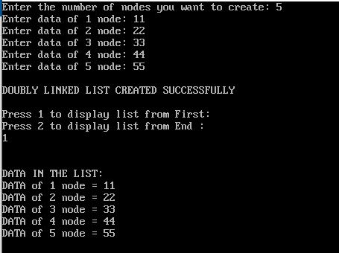
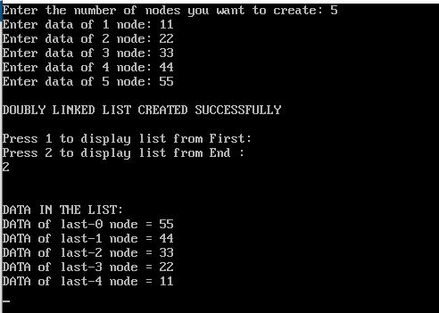
Output:

Slide 82
2. Insertion
In a doubly linked list, the insertion operation can be performed in three ways. They are as follows.
Inserting a node at the beginning of list.
Inserting a node at the end of list.
Inserting node at the middle (or at any position) of Doubly Linked List.

Slide 83
How to insert a new node at the beginning of a Doubly Linked List.

Slide 84
Inserting a node at the beginning of list:
Algorithm: [METHOD 1]
Step 1: Create a newNode with given value and
newNode → previous as NULL.
Step 2: Check whether list is Empty (head == NULL)
Step 3: If it is Empty then, assign
NULL to newNode →next and newNode to head.
Step 4: If it is not Empty then,
assign head to newNode →next and newNode to head.
Step 5: Again assign address of newNode to the left link of node pointed by the right link of newNode.

Slide 85
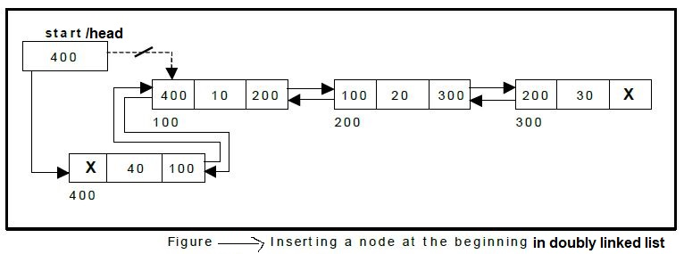
Example:

Slide 86
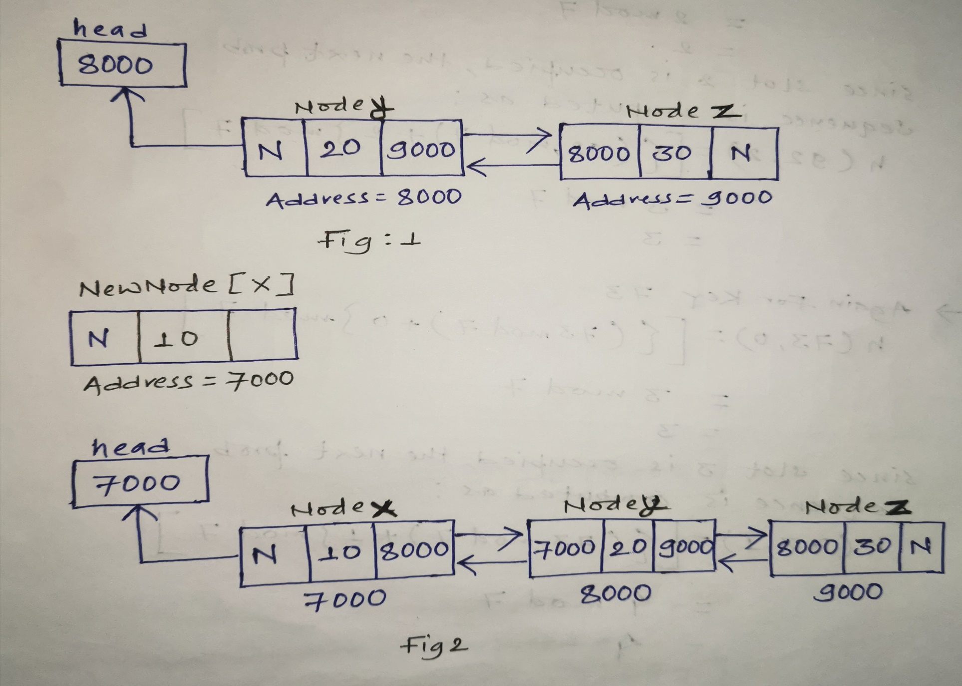
We can draw a figure like this to insert a node at the beginning:

Slide 87
a. Inserting a node at the beginning of list:
Algorithm: [METHOD 2]
Create a new node.
Read the data.
Insert data to the data field.
Assign left field of new node with null value.
Assign value of head to the right link of new node.
Assign the address of new node to the left link of node pointed by right link of new node.
Assign the address of new node to head.

Slide 88
How to insert a new node at the end of a Doubly Linked List.

Slide 89
b. Inserting a node at the end of list:
Algorithm: [METHOD 1]
Step 1: Create a newNode with given value and
newNode → previous as NULL.
Step 2: Check whether list is Empty (head == NULL)
Step 3: If it is Empty then, assign
NULL to newNode →next and newNode to head.
Step 4: If it is not Empty, then, define a node pointer temp and initialize with head.
Step 5: Keep moving the temp to its next node until it reaches to the last node in the list (until temp → next is equal to NULL).
Step 6: Assign newNode to temp → next and
temp to newNode → previous.

Slide 90
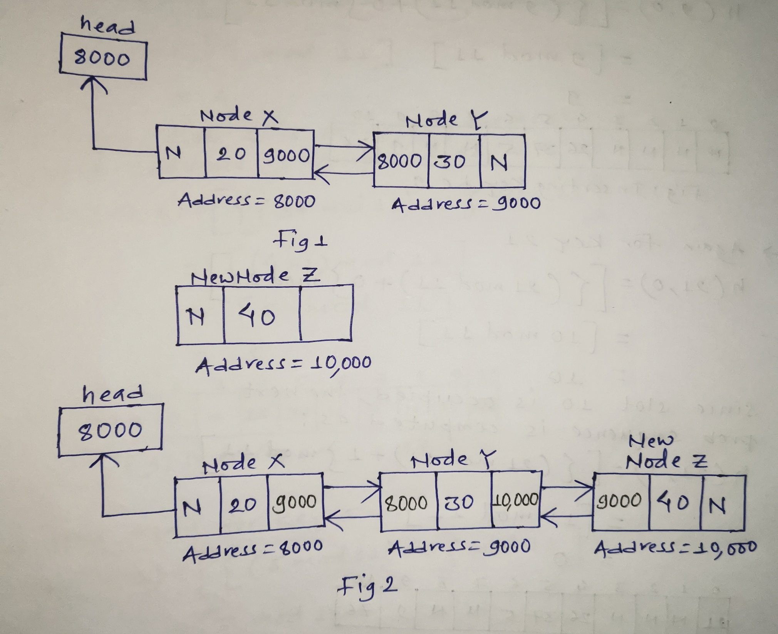

Slide 91
b. Inserting a node at the end of list:
Algorithm: [METHOD 2]
Create a new node.
Read the data.
Insert data to the data field.
Find the last node of linked list.
Assign the address of last node to the left link of new node.
Assign the address of new node to the right link of last node.
Assign the right link of new node with null value.

Slide 92
How to insert a new node at the middle (or at any position) of a Doubly Linked List.

Slide 93
Inserting a node at the middle (or at any position) of list:
Algorithm:
Step 1: Create a newNode with given value and
newNode → previous as NULL.
Step 2: Check whether list is Empty (head == NULL)
Step 3: If it is Empty then, assign
NULL to newNode →next and newNode to head.
Step 4: If it is not empty Search the target node.
If the target node is not found
Display the message and stop.
else
Step 5: Copy the address of right link of target node to the right link of new node.
Step 6: Copy the content of left link of node pointed by right link of target node to the left link of new node.
Step 7: Assign the address of new node to the right link of target node and left link of node pointed by right link of target node.

Slide 94
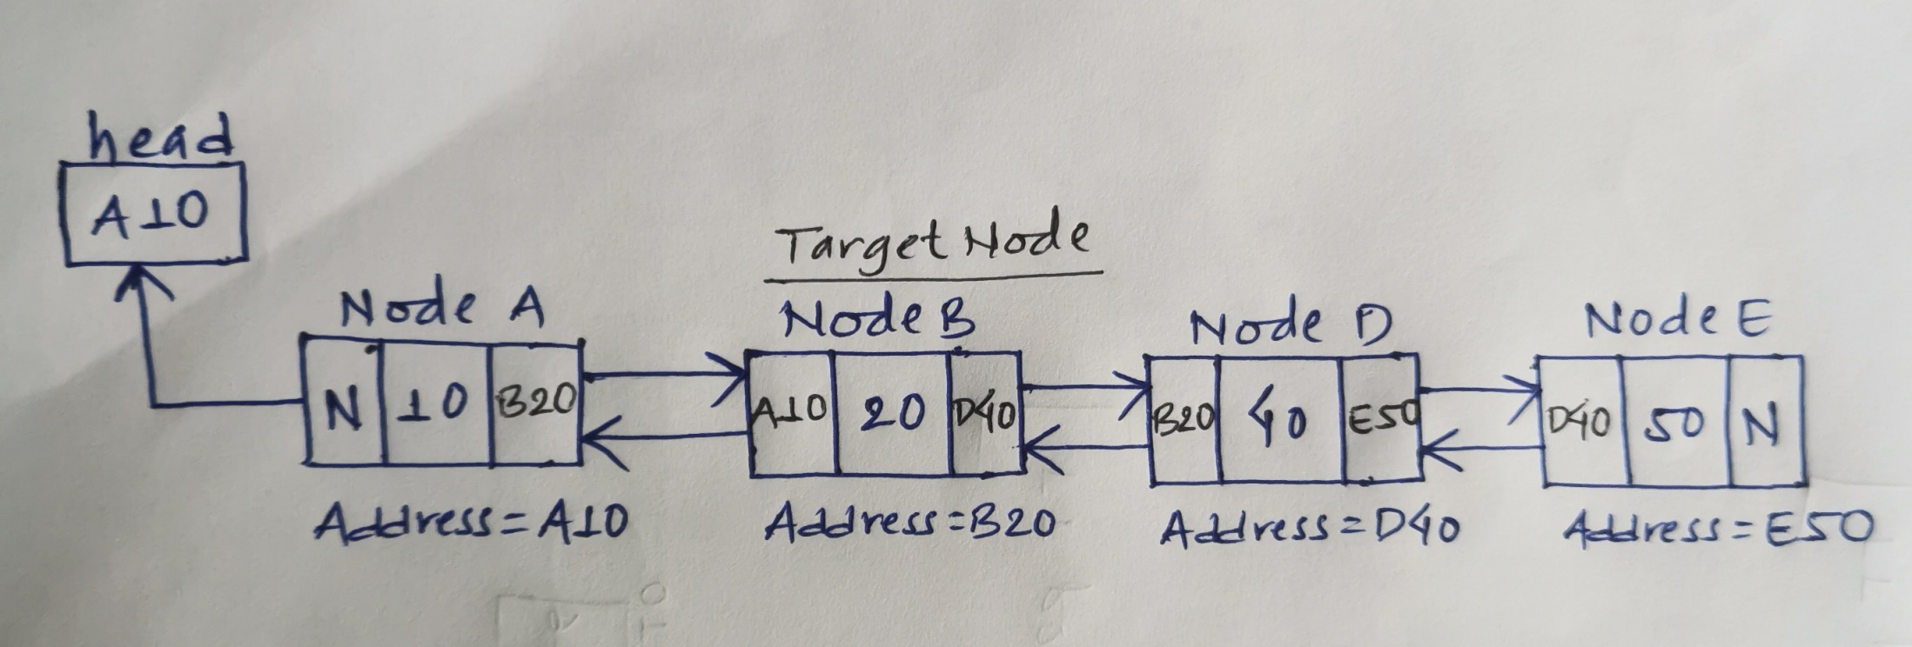
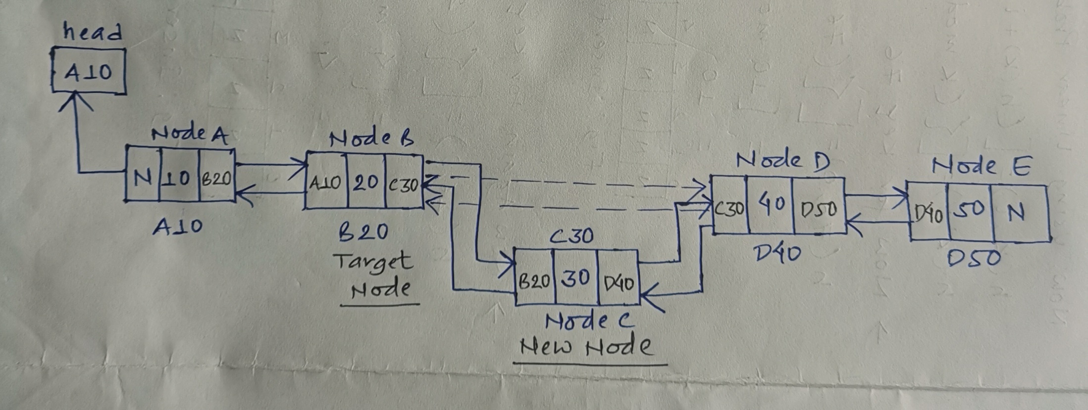

Slide 95
Program 9
Write a C program to create a doubly linked list and insert a new node in beginning, end or at any position in the list.
Note : for code go through this link
https://codeforwin.org/2015/10/c-program-to-insert-node-in-doubly-linked-list.html

Slide 96
/**
a C program to create a doubly linked list and insert a new node in beginning, end or at any position in the list. (double3.cpp)
*/
#include <stdio.h>
#include <conio.h>
#include <stdlib.h>
/*
* Basic structure of Node
*/
struct node {
int data;
struct node * prev;
struct node * next;
}*head, *last;
/*
* Function used in this program
*/
void createList(int n);
void displayList();
void insertAtBeginning(int data);
void insertAtEnd(int data);
void insertAtN(int data, int position);

Slide 97
int main()
{
int n, data, choice=1;
clrscr();
head = NULL;
last = NULL;
/*
* Run forever until user chooses 0
*/
while(choice != 0)
{
/*
* Menu creation to use the program
*/
printf("============================================\n");
printf("DOUBLY LINKED LIST PROGRAM\n");
printf("============================================\n");
printf("1. Create List\n");
printf("2. Insert node - at beginning\n");
printf("3. Insert node - at end\n");
printf("4. Insert node - at N\n");
printf("5. Display list\n");
printf("0. Exit\n");
printf("--------------------------------------------\n");
printf("Enter your choice : ");
scanf("%d", &choice);
/*
* Choose from different menu operation
*/
switch(choice)
{
case 1:
printf("Enter the total number of nodes in list: ");
scanf("%d", &n);
createList(n);
break;
case 2:
printf("Enter data of first node : ");
scanf("%d", &data);
insertAtBeginning(data);
break;
case 3:
printf("Enter data of last node : ");
scanf("%d", &data);
insertAtEnd(data);
break;
case 4:
printf("Enter the position where you want to insert new node: ");
scanf("%d", &n);
printf("Enter data of %d node : ", n);
scanf("%d", &data);
insertAtN(data, n);
break;
case 5:
displayList();
break;
case 0:
break;
default:
printf("Error! Invalid choice. Please choose between 0-5");
}
printf("\n\n\n\n\n");
}
getch();
return 0;
}

Slide 98
/* Creates a doubly linked list of n nodes.
* @n Number of nodes to be created
*/
void createList(int n)
{
int i, data;
struct node *newNode;
if(n >= 1)
{
/*
* Create and link the head node
*/
head = (struct node *)malloc(sizeof(struct node));
printf("Enter data of 1 node: ");
scanf("%d", &data);
head->data = data;
head->prev = NULL;
head->next = NULL;
last = head;
/*
* Create and link rest of the n-1 nodes
*/
for(i=2; i<=n; i++)
{
newNode = (struct node *)malloc(sizeof(struct node));
printf("Enter data of %d node: ", i);
scanf("%d", &data);
newNode->data = data;
newNode->prev = last; // Link new node with the previous node
newNode->next = NULL;
last->next = newNode; // Link previous node with the new node
last = newNode; // Make new node as last/previous node
}
printf("\nDOUBLY LINKED LIST CREATED SUCCESSFULLY\n");
}
}

Slide 99
/**
* Display content of the list from beginning to end
*/
void displayList()
{
struct node * temp;
int n = 1;
if(head == NULL)
{
printf("List is empty.\n");
}
else
{
temp = head;
printf("DATA IN THE LIST:\n");
while(temp != NULL)
{
printf("DATA of %d node = %d\n", n, temp->data);
n++;
/* Move the current pointer to next node */
temp = temp->next;
}
}
}
/**
* Inserts a new node at the beginning of the doubly linked list
* @data Data of the first node i.e. data of the new node
*/
void insertAtBeginning(int data)
{
struct node * newNode;
if(head == NULL)
{
printf("Error, List is Empty!\n");
}
else
{
newNode = (struct node *)malloc(sizeof(struct node));
newNode->data = data;
newNode->next = head; // Point to next node which is currently head
newNode->prev = NULL; // Previous node of first node is NULL
/* Link previous address field of head with newnode */
head->prev = newNode;
/* Make the new node as head node */
head = newNode;
printf("NODE INSERTED SUCCESSFULLY AT THE BEGINNING OF THE LIST\n");
}
}

Slide 100
/**
* Inserts a new node at the end of the doubly linked list
* @data Data of the last node i.e data of the new node
*/
void insertAtEnd(int data)
{
struct node * newNode;
if(last == NULL)
{
printf("Error, List is empty!\n");
}
else
{
newNode = (struct node *)malloc(sizeof(struct node));
newNode->data = data;
newNode->next = NULL;
newNode->prev = last;
last->next = newNode;
last = newNode;
printf("NODE INSERTED SUCCESSFULLY AT THE END OF LIST\n");
}
}
/**
* Inserts a node at any position in the doubly linked list
* @data Data of the new node to be inserted
* @position Position where to insert the new node
*/
void insertAtN(int data, int position)
{
int i;
struct node * newNode, *temp;
if(head == NULL)
{
printf("Error, List is empty!\n");
}
else
{
temp = head;
i=1;
while(i<position-1 && temp!=NULL)
{
temp = temp->next;
i++;
}
if(position == 1)
{
insertAtBeginning(data);
}
else if(temp == last)
{
insertAtEnd(data);
}
else if(temp!=NULL)
{
newNode = (struct node *)malloc(sizeof(struct node));
newNode->data = data;
newNode->next = temp->next; // Connect new node with n+1th node
newNode->prev = temp; // Connect new node with n-1th node
if(temp->next != NULL)
{
/* Connect n+1th node with new node */
temp->next->prev = newNode;
}
/* Connect n-1th node with new node */
temp->next = newNode;
printf("NODE INSERTED SUCCESSFULLY AT %d POSITION\n", position);
}
else
{
printf("Error, Invalid position\n");
}
}
}

Slide 101
3. Deletion
In a double linked list, the deletion operation can be performed in three ways. They are as follows.
Deleting from Beginning of the list
Deleting from End of the list
Deleting a Specific Node(i.e middle node or at any position)

Slide 102
How to delete first node from double linked list
NOTE:
[Good site for DSA]
http://www.btechsmartclass.com/

Slide 103
a. Deleting from Beginning of the list
Algorithm:
Step 1: Check whether list is Empty (head == NULL)
Step 2: If it is Empty then, display 'List is Empty!!! Deletion is not possible' and terminate the function.
Step 3: If it is not Empty then, define a Node pointer 'temp' and initialize with head.
Step 4: Check whether list is having only one node
(temp → previous and temp → next both are NULL.)
here temp is newNode
Step 5: If it is TRUE, then set head to NULL and delete temp (Setting Empty list conditions)
Step 6: If it is FALSE, then assign temp → next to head and Assign the null to the left link of the node pointed by right link of temp node( or first node), and finally delete temp.

Slide 104
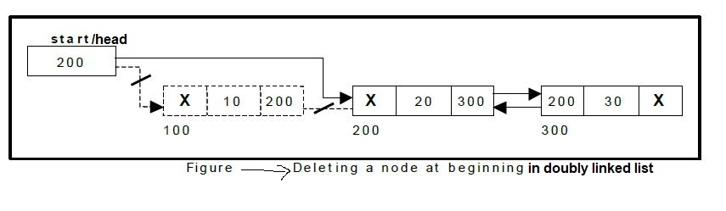

Slide 105
How to delete last node from doubly linked list

Slide 106
b. Deleting from End of the list
Algorithm: [METHOD 1]
Step 1: Check whether list is Empty (head == NULL)
Step 2: If it is Empty then, display 'List is Empty!!! Deletion is not possible' and terminate the function.
Step 3: If it is not Empty then, define a Node pointer 'temp' and initialize with head.
Step 4: Check whether list is having only one node
(temp → previous and temp → next both are NULL.)
here temp is newNode
Step 5: If it is TRUE, then set head to NULL and delete temp (Setting Empty list conditions)
Step 6: If it is FALSE, then keep moving temp until it reaches to the last node in the list. (until temp → next is equal to NULL)
Step 7: Assign NULL to temp → previous → next , again put the NULL value to the right address filed of node which is pointed by the left field of temp node and finally delete temp

Slide 107
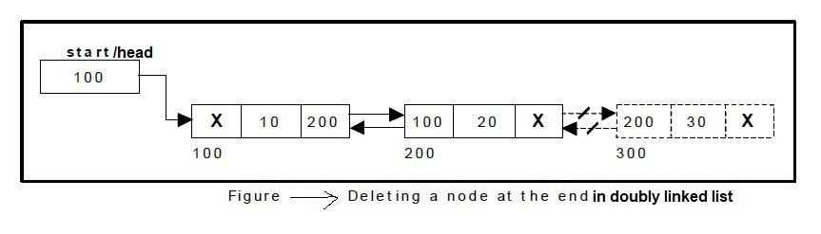

Slide 108
How to delete a node at the middle (or at any position) of a Doubly Linked List.

Slide 109
c. delete middle node (or at any position) from doubly linked list
Algorithm
Step 1: Check whether list is Empty (head == NULL)
Step 2: If it is Empty then, display 'List is Empty!!! Deletion is not possible' and terminate the function.
Step 3: If it is Not Empty then, define a Node pointer 'temp' and initialize with head.
Step 4: Check whether list has only one Node (temp1 → next == NULL)
Step 5: If it is TRUE. Then, set head = NULL and delete temp1. And terminate the function. (Setting Empty list condition)
Step 6: If it is FALSE then Traverse the doubly linked list to search the target node. (i.e. exact node which we want to delete)
Step 7: If the target node is not found
Display the message and stop.
else
Step 8: Copy the content of right link of target node to the right link of a node which is pointed by the left link of target node.
Step 9: Copy the content of left link of target node to the left link of a node pointed by the right link of target node.

Slide 110
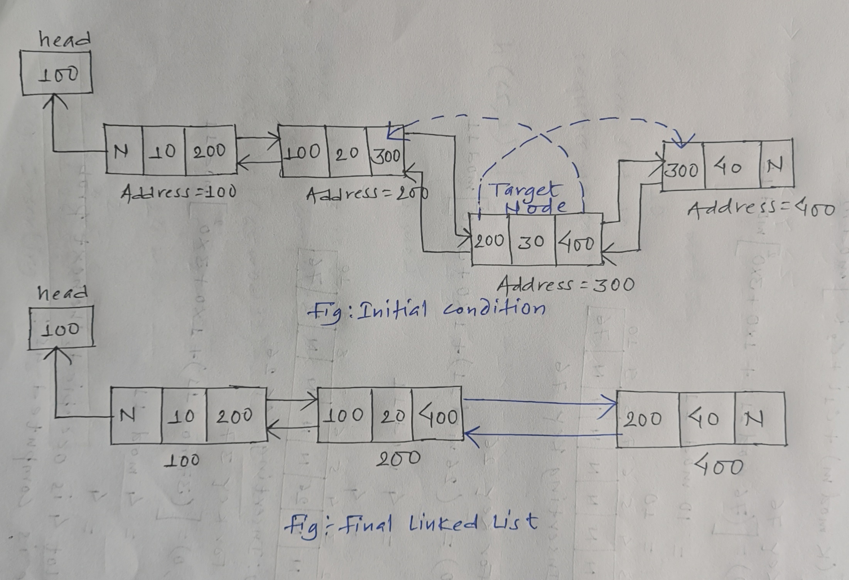

Slide 111
Program 10
Write a C program to create a doubly linked list and delete a node from beginning, end or at any position of the linked list.
Note: go through this link for code:
https://codeforwin.org/2015/10/c-program-to-delete-node-from-doubly-linked-list.html

Slide 112
/**
a C program to create a doubly linked list and delete a node from beginning, end or at any position of the linked list. (double2.cpp)
*/
#include <stdio.h>
#include <conio.h>
#include <stdlib.h>
/*
* Basic structure of Node
*/
struct node {
int data;
struct node * prev;
struct node * next;
}*head, *last;
/*
* Functions used in this program
*/
void createList(int n);
void displayList();
void deleteFromBeginning();
void deleteFromEnd();
void deleteFromN(int position);

Slide 113
int main()
{
int n, data, choice=1;
clrscr();
head = NULL;
last = NULL;
/*
* Run forever until user chooses 0
*/
while(choice != 0)
{
printf("============================================\n");
printf("DOUBLY LINKED LIST PROGRAM\n");
printf("============================================\n");
printf("1. Create List\n");
printf("2. Delete node - from beginning\n");
printf("3. Delete node - from end\n");
printf("4. Delete node - from N\n");
printf("5. Display list\n");
printf("0. Exit\n");
printf("--------------------------------------------\n");
printf("Enter your choice : ");
scanf("%d", &choice);
switch(choice)
{
case 1:
printf("Enter the total number of nodes in list: ");
scanf("%d", &n);
createList(n);
break;
case 2:
deleteFromBeginning();
break;
case 3:
deleteFromEnd();
break;
case 4:
printf("Enter the node position which you want to delete: ");
scanf("%d", &n);
deleteFromN(n);
break;
case 5:
displayList();
break;
case 0:
break;
default:
printf("Error! Invalid choice. Please choose between 0-5");
}
printf("\n\n\n\n\n");
}
getch();
return 0;
}

Slide 114
/**
* Creates a doubly linked list of n nodes.
* @n Number of nodes to be created
*/
void createList(int n)
{
int i, data;
struct node *newNode;
if(n >= 1)
{
/*
* Creates and links the head node
*/
head = (struct node *)malloc(sizeof(struct node));
printf("Enter data of 1 node: ");
scanf("%d", &data);
head->data = data;
head->prev = NULL;
head->next = NULL;
last = head;
/*
* Create and link rest of the n-1 nodes
*/
for(i=2; i<=n; i++)
{
newNode = (struct node *)malloc(sizeof(struct node));
printf("Enter data of %d node: ", i);
scanf("%d", &data);
newNode->data = data;
newNode->prev = last; // Link new node with the previous node
newNode->next = NULL;
last->next = newNode; // Link previous node with the new node
last = newNode; // Make new node as last node
}
printf("DOUBLY LINKED LIST CREATED SUCCESSFULLY\n");
}
}

Slide 115
/**
* Display the content of the list from beginning to end
*/
void displayList()
{
struct node * temp;
int n = 1;
if(head == NULL)
{
printf("List is empty.\n");
}
else
{
temp = head;
printf("DATA IN THE LIST:\n");
while(temp != NULL)
{
printf("DATA of %d node = %d\n", n, temp->data);
n++;
/* Move the current pointer to next node */
temp = temp->next;
}
}
}
/**
* Delete or remove the first node of the doubly linked list
*/
void deleteFromBeginning()
{
struct node * toDelete;
if(head == NULL)
{
printf("Unable to delete. List is empty.\n");
}
else
{
toDelete = head;
head = head->next; // Move head pointer to 2 node
if (head != NULL)
head->prev = NULL; // Remove the link to previous node
free(toDelete); // Delete the first node from memory
printf("SUCCESSFULLY DELETED NODE FROM BEGINNING OF THE LIST.\n");
}
}

Slide 116
/**
* Delete or remove the last node of the doubly linked list
*/
void deleteFromEnd()
{
struct node * toDelete;
if(last == NULL)
{
printf("Unable to delete. List is empty.\n");
}
else
{
toDelete = last;
last = last->prev; // Move last pointer to 2nd last node
if (last != NULL)
last->next = NULL; // Remove link to of 2nd last node with last node
free(toDelete); // Delete the last node
printf("SUCCESSFULLY DELETED NODE FROM END OF THE LIST.\n");
}
}
/**
* Delete node from any position in the doubly linked list
*/
void deleteFromN(int position)
{
struct node *current;
int i;
current = head;
for(i=1; i<position && current!=NULL; i++)
{
current = current->next;
}
if(position == 1)
{
deleteFromBeginning();
}
else if(current == last)
{
deleteFromEnd();
}
else if(current != NULL)
{
current->prev->next = current->next;
current->next->prev = current->prev;
free(current); // Delete the n node
printf("SUCCESSFULLY DELETED NODE FROM %d POSITION.\n", position);
}
else
{
printf("Invalid position!\n");
}
}

Slide 117
Program 11
Write a C program to create a doubly linked list and reverse the linked list. How to reverse the doubly linked list in C programming.
Note: click this link for reverse the linked list.
https://codeforwin.org/2015/11/c-program-to-reverse-doubly-linked-list.html

Slide 118
/**
* C program to reverse a Doubly linked list
*/
#include <stdio.h>
#include <conio.h>
#include <stdlib.h>
/*
* Basic structure of Node
*/
struct node {
int data;
struct node * prev;
struct node * next;
}*head, *last;
/*
* Functions used in this program
*/
void createList(int n);
void displayList();
void reverseList();

Slide 119
int main()
{
int n, data, choice=1;
clrscr();
head = NULL;
last = NULL;
/*
* Runs forever until user chooses 0
*/
while(choice != 0)
{
printf("============================================\n");
printf("DOUBLY LINKED LIST PROGRAM\n");
printf("============================================\n");
printf("1. Create List\n");
printf("2. Reverse List\n");
printf("3. Display list\n");
printf("0. Exit\n");
printf("--------------------------------------------\n");
printf("Enter your choice : ");
scanf("%d", &choice);
switch(choice)
{
case 1:
printf("Enter the total number of nodes in list: ");
scanf("%d", &n);
createList(n);
break;
case 2:
reverseList();
break;
case 3:
displayList();
break;
case 0:
break;
default:
printf("Error! Invalid choice. Please choose between 0-3");
}
printf("\n\n\n\n\n");
}
getch();
return 0;
}

Slide 120
/**
* Creates a doubly linked list of n nodes.
* @n Number of nodes to be created
*/
void createList(int n)
{
int i, data;
struct node *newNode;
if(n >= 1)
{
/*
* Create and link head node
*/
head = (struct node *)malloc(sizeof(struct node));
printf("Enter data of 1 node: ");
scanf("%d", &data);
head->data = data;
head->prev = NULL;
head->next = NULL;
last = head;
/*
* Create and link rest of the n-1 nodes
*/
for(i=2; i<=n; i++)
{
newNode = (struct node *)malloc(sizeof(struct node));
printf("Enter data of %d node: ", i);
scanf("%d", &data);
newNode->data = data;
newNode->prev = last; // Link new node with the previous node
newNode->next = NULL;
last->next = newNode; // Link previous node with the new node
last = newNode; // Make new node as last/previous node
}
printf("\nDOUBLY LINKED LIST CREATED SUCCESSFULLY\n");
}
}

Slide 121
/**
* Display the content of the list from beginning to end
*/
void displayList()
{
struct node * temp;
int n = 1;
if(head == NULL)
{
printf("List is empty.\n");
}
else
{
temp = head;
printf("DATA IN THE LIST:\n");
while(temp != NULL)
{
printf("DATA of %d node = %d\n", n, temp->data);
n++;
/* Move pointer to next node */
temp = temp->next;
}
}
}
/**
* Reverse order of the doubly linked list
*/
void reverseList()
{
struct node *current, *temp;
current = head;
while(current != NULL)
{
/*
* Swap the previous and next address fields of current node
*/
temp = current->next;
current->next = current->prev;
current->prev = temp;
/* Move the current pointer to next node which is stored in temp */
current = temp;
}
/*
* Swap the head and last pointers
*/
temp = head;
head = last;
last = temp;
printf("LIST REVERSED SUCCESSFULLY.\n");
}

Slide 122
Advantages of Doubly linked list
Allows traversal of nodes in both direction which is not possible in singly linked list.
Deletion of nodes is easy when compared to singly linked list, as in singly linked list deletion requires a pointer to the node and previous node to be deleted. Which is not in case of doubly linked list we only need the pointer which is to be deleted.
Reversing the list is simple and straightforward.
Can allocate or de-allocate memory easily when required during its execution.
It is one of most efficient data structure to implement when traversing in both direction is required.

Slide 123
Disadvantages of Doubly linked list
It uses extra memory when compared to array and singly linked list.
Insertion and deletion take more time than linear linked list because more pointer operations are required than linear linked list.

Slide 124
Implementing Stacks and Queues with Linked Lists
Because linked lists store data elements in linear sequences, they can be used to give alternative implementations of stacks and queues.
One advantage to using linked lists is that we don't have to worry about filling up something like an array - we can just keep allocating cells as long as we need to (unless we run out of memory).

Slide 125
Implementing a stack using a linked list is particularly easy because all accesses to a stack are at the top. One end of a linked list, the beginning, is always directly accessible. We should therefore arrange the elements so that the top element of the stack is at the beginning of the linked list, and the bottom element of the stack is at the end of the linked list. We can represent an empty stack with null.

Slide 126
The public methods Push, Peek, and Pop are then fairly straightforward to implement. For Push we need to add the given element to a new cell at the beginning of the linked list, as shown in the previous section, and update the Count. To implement Peek, if the stack is nonempty, we simply return the Data property of the cell at the beginning of the linked list; otherwise, we throw an InvalidOperationException. To implement Pop:
Using Peek, obtain the element to be returned;
Remove the first element from the linked list as shown in the previous section;
Update the Count; and
Return the retrieved value.

Slide 127
Implementing a queue is a little more involved because we need to operate at both ends of the linked list. For efficiency, we should keep a reference to the last cell in the linked list, as this will allow us to access both ends of the linked list directly.

Slide 128
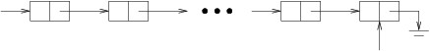
We will therefore have the following:
We now need to decide which end to make the front of the queue. As we saw in the previous section, both inserting and removing can be done efficiently at the beginning of a linked list. Likewise, it is easy to insert an element at the end if we have a reference to the last cell. Suppose, for example, that last refers to the last cell in a linked list, and that cell refers to a LinkedListCell<T> that we want to insert at the end. Suppose further that the linked list is not empty (that will be a special case that we'll need to handle).

Slide 129
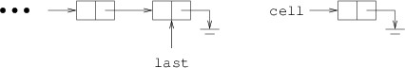
We therefore need to:
Construct a new LinkedListCell<T>;
Assign it to the field denoting the front of the queue;
Assign it to the field denoting the back of the queue;
Store the given element in its Data property; and
Update the Count.
Note that there is no need to initialize the new cell's Next property, as it will automatically be initialized to null.
If the queue is nonempty, the only step that changes is Step 2. Because the queue is nonempty, we don't want to make the new cell the front of the queue; instead, we need to insert it at the end of the linked list, as outlined above.
The implementations of the Peek and Dequeue methods are essentially the same as the implementations of the Peek and Pop methods, respectively, for a stack.

Slide 130
The implementations described in this section are simpler than the implementations using arrays, mainly due to the fact that we don't need to rebuild the structure when we fill up the space available. While these implementations are also pretty efficient, it turns out that the array-based implementations tend to out-perform the linked-list-based implementations. This might be counterintuitive at first because rebuilding the structures when the array is filled is expensive. However, due to the fact that we double the size of the array each time we need a new one, this rebuilding is done so rarely in practice that it ends up having minimal impact on performance. Due to hardware and low-level software issues, the overhead involved in using arrays usually ends up being less.

Slide 131
Assignment

Slide 132
What is linked list? Write down the advantages and disadvantage of linked list.
What is singly linked list? Explain with an example.
Write down the basic structure of single linked list. What are the basic operation of single linked list?
Write down the algorithm to insert a node at the beginning of a single linked list.
Write down the algorithm to insert a node at the end of a single linked list.
Write down the algorithm to insert a node at the middle of a single linked list.
Write down the algorithm to delete a node at the beginning of a single linked list.
Write down the algorithm to delete a node at the end of a single linked list.
Write down the algorithm to delete a node at the middle of a single linked list.

Slide 133
What are the advantages and disadvantages of singly linked list?
What is doubly linked list? Explain with an example.
Write down the basic structure of double linked list. What are the basic operation of double linked list?
Write down the algorithm to insert a node at the beginning of a double linked list.
Write down the algorithm to insert a node at the end of a double linked list.
Write down the algorithm to insert a node at the middle of a double linked list.
Write down the algorithm to delete a node at the beginning of a double linked list.
Write down the algorithm to delete a node at the end of a double linked list.
Write down the algorithm to delete a node at the middle of a double linked list.

Slide 134
What are the advantages and disadvantages of doubly linked list?
What are the advantages & disadvantages of doubly linked list over singly linked list? Justify with an example.

